Slide 1
EDA GROUP CASE STUDY
By:
GOPINATH KAMBLE
NIKHIL GUPTA

Slide 2
INTRODUCTION
This case study aims to give us an idea of applying EDA in a real business scenario. In this case study, we develop a basic understanding of risk analytics in banking and financial services and understand how data is used to minimise the risk of losing money while lending to customers.

Slide 3
BUSINESS OBJECTIVES
This case study aims to identify patterns which indicate if a client has difficulty paying their installments which may be used for taking actions such as denying the loan, reducing the amount of loan, lending (to risky applicants) at a higher interest rate, etc. This will ensure that the consumers capable of repaying the loan are not rejected. Identification of such applicants using EDA is the aim of this case study.
The company wants to understand the driving factors (or driver variables) behind loan default, i.e. the variables which are strong indicators of default. The company can utilise this knowledge for its portfolio and risk assessment.

Slide 4
STEPS
Import Libraries
Reading and Inspection
3. Check missing values
4. Impute/Remove missing values
5. Checking Datatypes
6. Handling Outliers
7. Binning Continuous Variable
8. Analysis

Slide 5
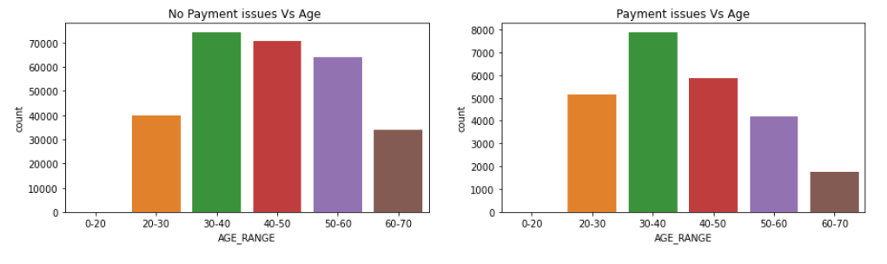
Analysis on Age
We can see that age range 30-40 and 40-50 have are able to make payment on time and can be considered while lending loan.

Slide 6
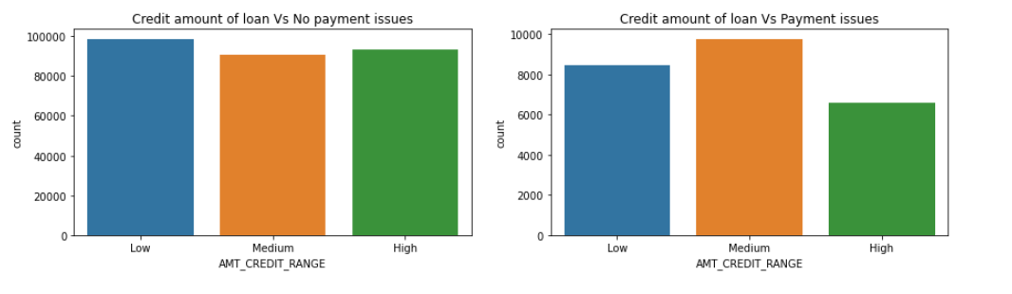
Analysis on Credit amount of loan
customers with medium credit have more payment issue.
customers with low credit have less payment issue.

Slide 7
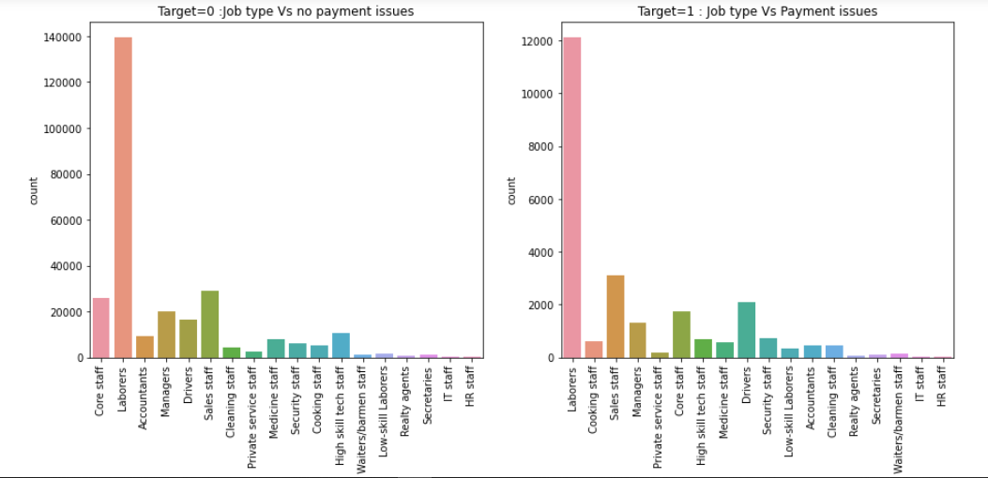
Analysis on OCCUPATION_TYPE
we can see that labores have no payment issue than other.
Sales staff, drivers and core staff have more difficulty to paying their installments

Slide 8
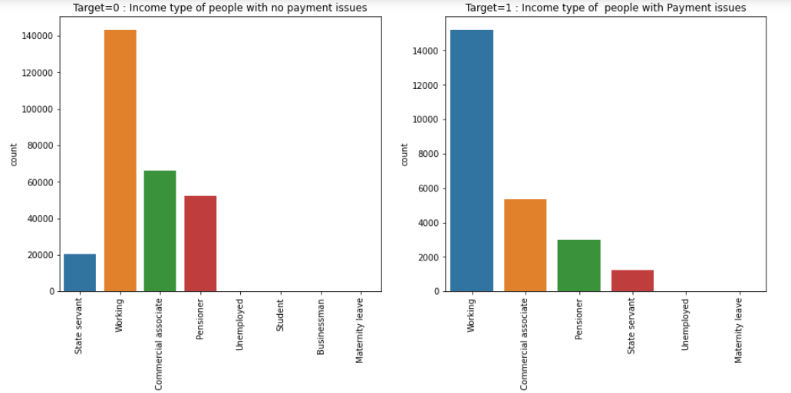
Analysis on INCOME_TYPE
The plot clearly shows that working are most likely to make payment on time whereas unemployed are difficulty to make payment on time

Slide 9
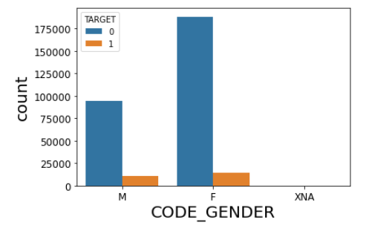
Analysis on GENDER
Less number of males take loans but the defaulters are higher in case of males.
Female customers pay loan amount on time and banks can target more female customers for lending loan

Slide 10
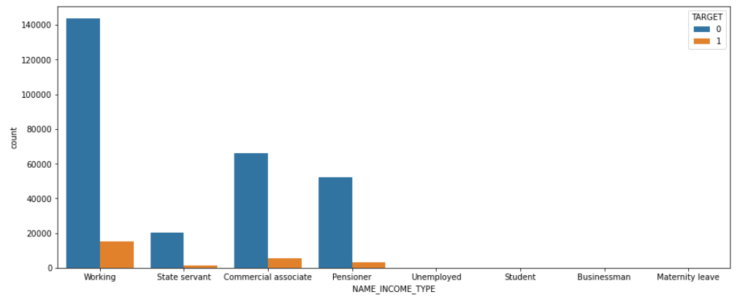
INCOME TYPES
Pensioner defaulter is lower than non defaulter.
working income types are more interested in loan.
Working customers can be targetted to lend loans as they have higher percentage of making payments on time.
But in working customers defaulter is higher than other we can choose different interest rate for working customers

Slide 11
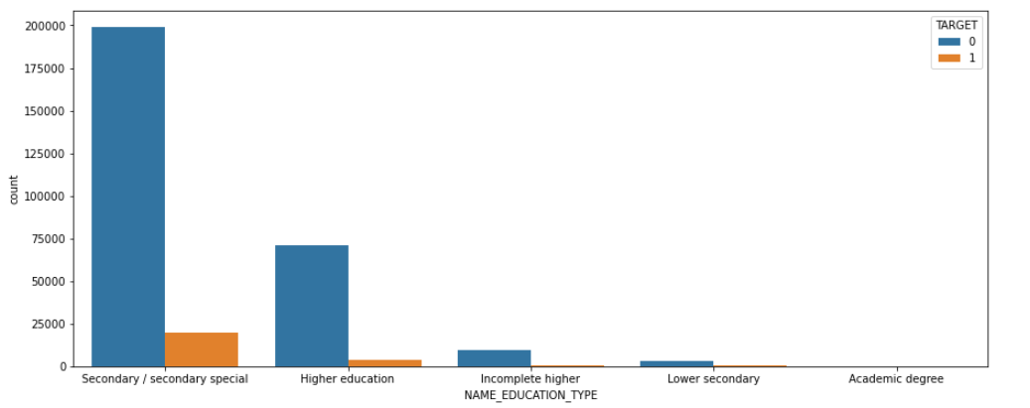
ANALYSIS ON EDUCATION TYPE
Most customers take loan from secondary education followed by higher education. But the default rate in secondary education is much high and for higher education is much low.
Less educated people is not interested in loan other than educated people. count of less educated people have loan is very less.
Customers with secondary education are most likely to make payments when compared to customers with academic degree.

Slide 12
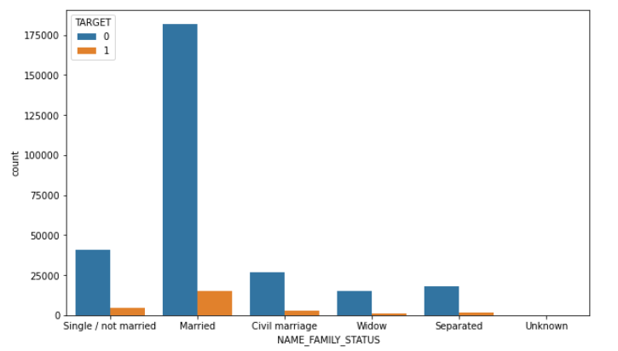
ANLYSIS ON FAMILY STATUS
Most customers who are married take loan followed by single.
Also in married, defaulters are high as compare to others
Married customers have paid loan amount on time when compared to widows.

Slide 13
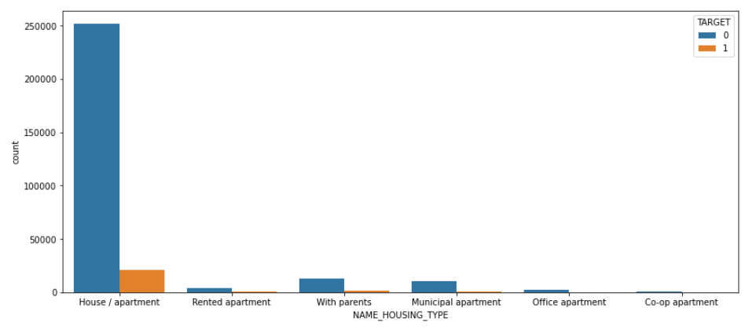
ANLYSIS ON HOUSING TYPE
Customers owning House/apartment are most likely to make payments on time compared to those living in CO-OP apartment.

Slide 14
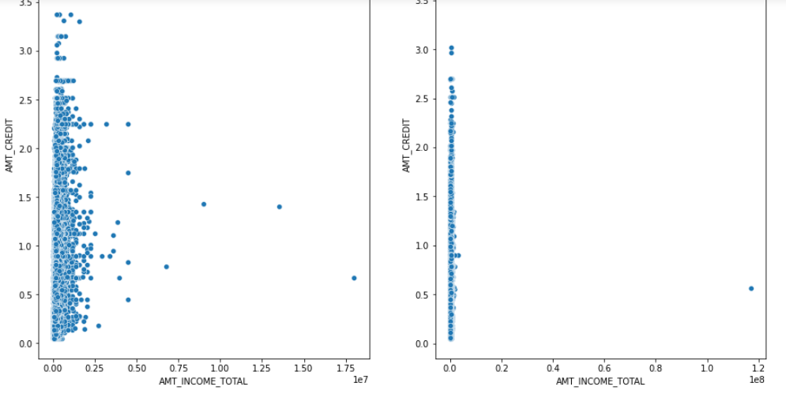
'AMT_INCOME_TOTAL vs AMT_CREDIT
Those who have paid the loan amount on/within time are more likely to get higher credits than those who didn’t pay did late payments.

Slide 15
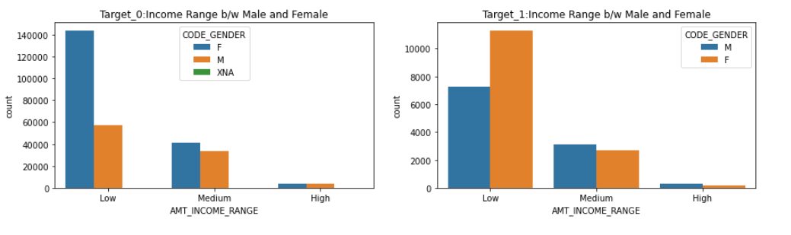
INCOME RANGE B/W MALE & FEMALE
Female which have low income are good in repay loan in time and don't have payment issues
But it is opposite in men side, men have low income have more payment issues

Slide 16
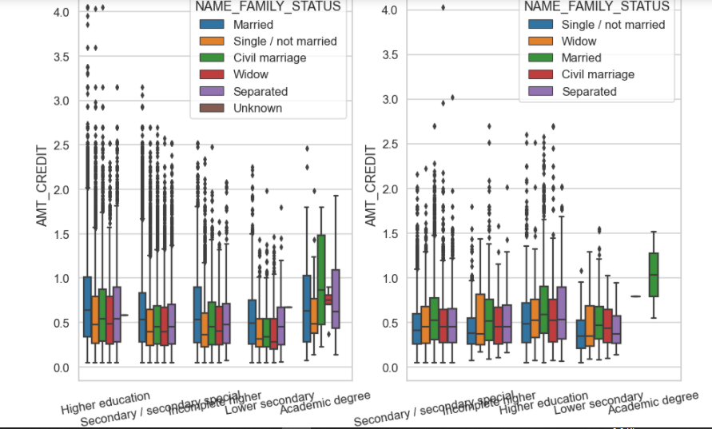
Credit amount vs Education Status
Some of the highly educated, married person are having credits higher than those who have done lower secondary eduction.
Those with higher education have higher credits and are more likely to make payments on time.
More number of outliers are seen in higher education.
The people with secondary and secondary special education are less likely to make payments on time.

Slide 17
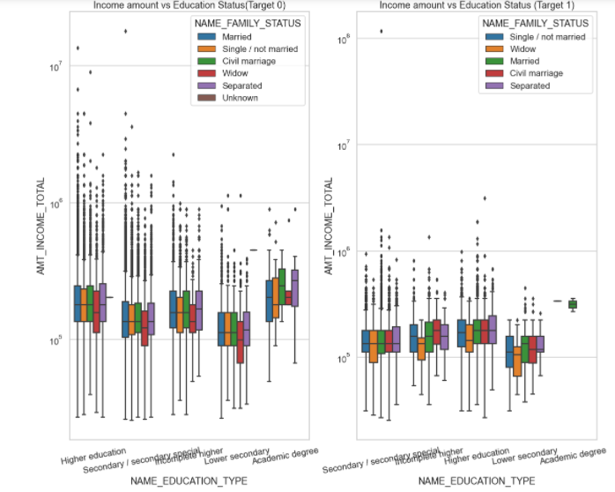
Income vs Education Status
We can see that Higher education has many outliers.
People with higher eductaion have higher income and dont have difficulties in making loan payment.
People with higher education who ave lesser income are unable to pay the loan.
Hence we can conclude that,people with Higher income are most likely to make payments.

Slide 18
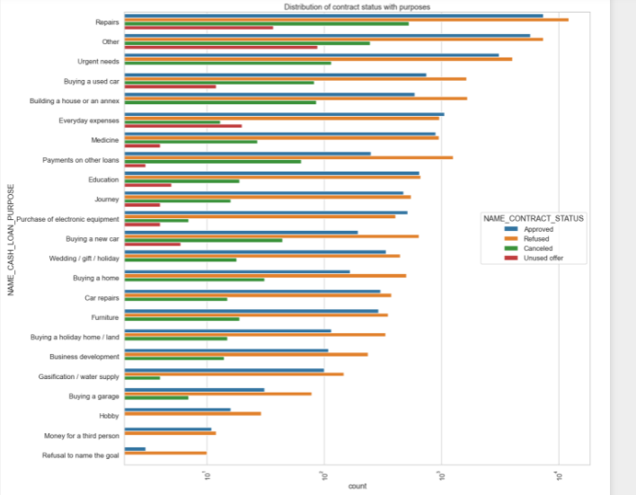
Distribution of contract status with purposes
Most rejection of loans came from purpose 'Repairs'.
For education purposes we have equal number of approves and rejection Paying other loans
buying a new car is having significant higher rejection than approves.

Slide 19
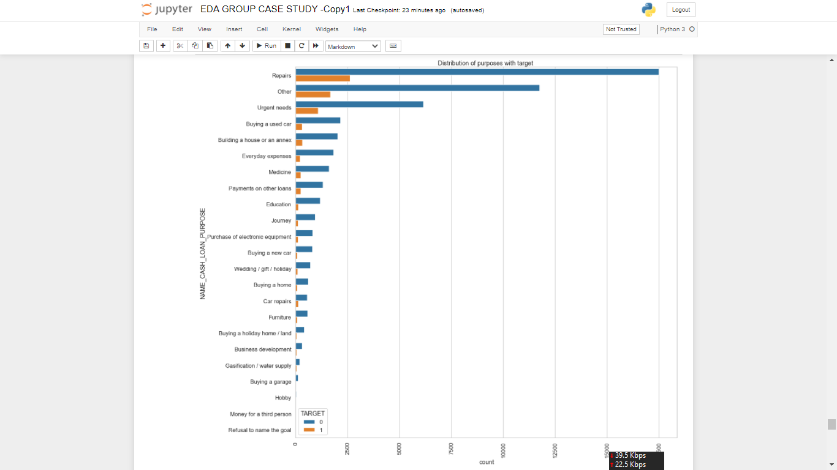
Distribution of purposes with target
Loan purposes with 'Repairs' are facing more difficulites in payment on time.
There are few places where loan payment is significant higher than facing difficulties.
They are 'Buying a garage', 'Business developemt', 'Buying land','Buying a new car' and 'Education'
Hence we can focus on these purposes for which the client is having for minimal payment difficulties

Slide 20
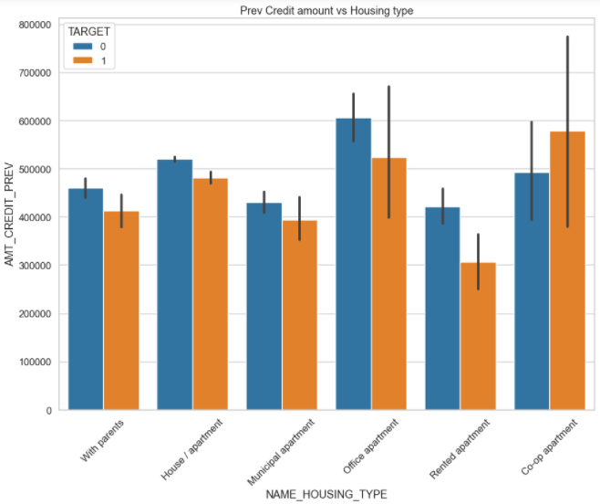
Prev Credit amount vs Housing typ
Here for Housing type, office apartment is having higher credit of target 0 and co-op apartment is having higher credit of target 1. So, we can conclude that bank should avoid giving loans to the housing type of co-op apartment as they are having difficulties in payment. Bank can focus mostly on housing type with parents or House apartment or municipal apartment for successful payments.

Slide 21
CONCLUSION
1. Banks should focus more on contract type ‘Student’ ,’pensioner’ and ‘Businessman’ with housing ‘type other than ‘Co-op apartment’ for successful payments.
2. Banks should focus less on income type ‘Working’ as they are having most number of unsuccessful payments.
3. Also with loan purpose ‘Repair’ is having higher number of unsuccessful payments on time.
4. Get as much as clients from housing type ‘With parents’ as they are having least number of unsuccessful payments.

